Slide 1
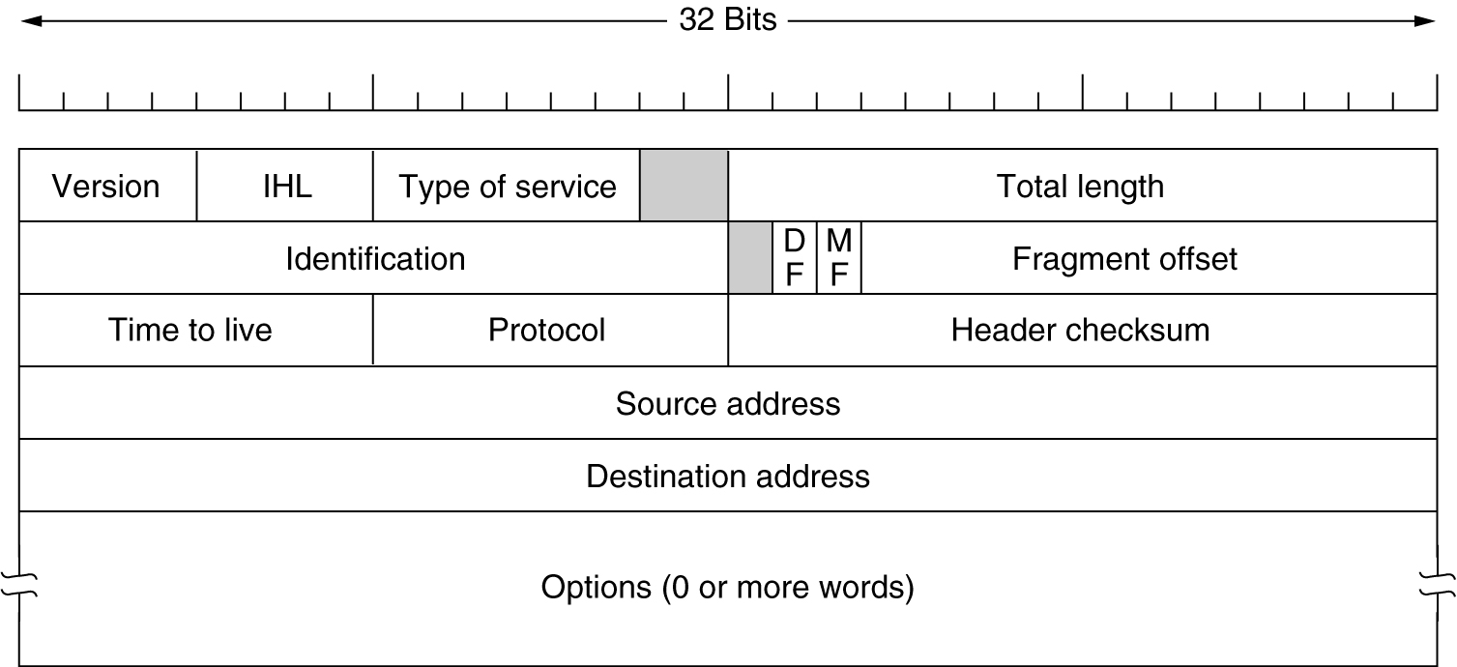
The IP Protocol
20 byte fixed length + variable part header + payload
The IPv4 (Internet Protocol) header.
Notes:
The header has 20 bytes fixed part and a variable part and of course the payload.
4 bit version field e.g, IP4 or IP6
Since the header length is not constant, a field in the header, IHL (Internet header length), is provided to tell how long the header is in terms of 32 bit words. The minimum value is 5 which mean no options are there. The maximum value of 4 bit field is 15 which means that the maximum header size is 60 bytes and thus the option field to 40 bytes.
Type of service is reserved to represent the class of services as we see in differentiated services.
Total length field is 16 bits and maximum value it can take is 65535.
Identification is used to relate fragments to the original packet. All fragments of the data contain the same value of Identification.
DF: do not fragment
MF: More fragments , All fragments except the last one have this bit set telling that more fragments are on the way, the last fragment does not set this bit telling that this is the last fragment.
Fragment offset: tells where in the current datagram this fragment belong to. All fragments except the last one should be a multiple of 8 bytes.
Time to live is a counter used to limit the lifetime of the packet.
It is supposed to count time in seconds and hence can give a maximum 256 sec life to a packet. In practice it just counts hops. When it hits zero, the packet is just discarded.
At the receiver side, when a complete datagram or IP packet is received, it should know which process the payload should be handed over. It is the Protocol field that tells about it. E.g, TCP or UDP or some other transport level protocol. The header checksum verifies the header only and is used to see if there are any errors in the header.
Source and Destination address shows the network number and host number.
The Options field was there to accommodate some extra information and functionality that was not considered at the design time.

